Slide 1

MICRON MEMORY TAIWAN CO., LTD.
F16 SLS SYSTEM UPGRADES
Gradiant Corporation – Proprietary and Confidential
[This document cannot be distributed outside of intended recipients]

Slide 2
DESIGN BASIS
 | Phase - 1 | Phase - 2
1. Feed Capacity | 2* 1000m3/day of Salix + 20m3/day IPA 3.05% and HF 1.54% + 180 m3/day of IPA 6% | Addition of 1000m3/day of Salix
2. Base Case (Working) | Feed to ROi: 1000m3/day of Salix (ROi recovery 80%) Feed to NH3-IPA recovery: 190m3/day of Salix (20% ROi reject) | Feed to ROi: 2000m3/day of Salix (ROi recovery 80%) Feed to NH3-IPA recovery: 380m3/day of Salix (20% ROi reject)
3. Alternate Case (Working) | Feed to ROi: 1000m3/day of Salix (ROi recovery 80%) Feed to NH3-IPA recovery: 190m3/day of Salix (20% ROi reject) + 20m3/day IPA 3.05% and HF 1.54% + 180 m3/day of IPA 6% | Feed to ROi: 2000m3/day of Salix (ROi recovery 80%) Feed to NH3-IPA recovery: 380m3/day of Salix (20% ROi reject) + 20m3/day IPA 3.05% and HF 1.54% + 180 m3/day of IPA 6%
Layout is designed to accommodate Phase 2 requirements
(i.e., total capacity of 3000 m3/day including 20m3/day IPA 3.05% and HF 1.54% + 180 m3/day of IPA 6%)
Gradiant Corporation – Proprietary and Confidential
[This document cannot be distributed outside of intended recipients]
Notes:
698 m3/day of Salix + 40 m3/week of HF/IPA + 180 m3/day of IPA 6%

Slide 3
PROPOSED CONFIGURATION FOR ROi
Tanks | 2 Working (Designed for a total capacity of 2000 m3/day)
Pumps & membranes | 1 Working +1 Standby during Phase 1 of 1000 m3/day 1 Working +1 Standby +1 Future during Phase 2 of 2000 m3/day
NOTE: During maintenance of any individual pumps or membranes, the standby unit will be automatically come into operation mode.
Gradiant Corporation – Proprietary and Confidential
[This document cannot be distributed outside of intended recipients]
Notes:
698 m3/day of Salix + 40 m3/week of HF/IPA + 180 m3/day of IPA 6%

Slide 4
PROPOSED CONFIGURATION FOR
NH3-IPA RECOVERY SYSTEM
Systems | 2 Working -Designed for a total capacity of 30 m3/hr (15+15)
Stripper & Distillation | Stripper(short-bed)：2 Working+1 Standby Pre-distillation(short-bed) w/Reboiler：2 Working+1 Standby NH3 distillation(column)：2 Working IPA distillation(short-bed)：2 Working+1 Standby
HX & Condenser & Receiver & Absorber & Tank | 2 Working
Pumps | 2 Working +2 Standby
Gradiant Corporation – Proprietary and Confidential
[This document cannot be distributed outside of intended recipients]
Notes:
698 m3/day of Salix + 40 m3/week of HF/IPA + 180 m3/day of IPA 6%

Slide 5
SALIX FEEDWATER QUALITY
Parameters | Units | Salix (Average) | Salix (Worse case)
pH | - | 3-10 | 3-10
COD | mg/l | <3187.5 | <3187.5
TSS | mg/l | 10.0 | <30
TDS | mg/l | 4267.0 | <5000
Conductivity | µS/cm | <9000 | <10546
SDI | - | <5 | <5
IPA | mg/l | <1667 | <2000
NH₃-N | mg/l | <1440 | <1440
F- | mg/l | <10 | <50
H₂0₂ | mg/l | <2000 | <2000
SiO₂ | mg/l | 177 | <200
Temperature | deg C | 30 | 30
Alkalinity (as CaCO3) | mg/l | <90 | <90
Hardness (as CaCO3) | mg/l | <16 | <16
Gradiant Corporation – Proprietary and Confidential
[This document cannot be distributed outside of intended recipients]
Notes:
Note: F- note –> mention Calcium, Hardness, Alkalinity

Slide 6
SALIX FEEDWATER QUALITY
S/N | Parameter | Limitation
1 | SiO2 | Above 200ppm will affect: ROi recovery Antiscalant selection is difficult Increase in IPA recovery system sizing & space
2 | NH3-N | Above 1440ppm will affect: ROi permeate quality of <5ppm May need further treatment like more membranes or degassers unit Additional space
3 | TDS | Above 5000ppm will affect: ROi permeate Conductivity quality of <300 µS/cm ROi recovery Requirement of more membranes Additional space.
4 | Fluoride | Above 50ppm will affect: ROi permeate quality Requirement of more membranes Additional space Frequent CIP Increased Antiscalant consumption
5 | IPA | Above 2000ppm will affect: Frequent CIP Lower membrane life <1.5 years
Notes:
Note: F- note –> mention Calcium, Hardness, Alkalinity

Slide 7
TREATED WATER QUALITY
1) For A3 Cooling Tower Makeup (RO Permeate)
2) Stripper Outlet
3) Outlet Air Quality
NH3-N | ppm | < 5
COD | ppm | < 400
F- | ppm | < 1
Conductivity | µS/cm | < 300
IPA | ppm | < 50
COD | ppm | < 150
NH3-N | ppm | < 30
THC | ppmv | <20
NH3 | ppmv | < 20
NOx | ppmv | < 50
Gradiant Corporation – Proprietary and Confidential
[This document cannot be distributed outside of intended recipients]

Slide 8

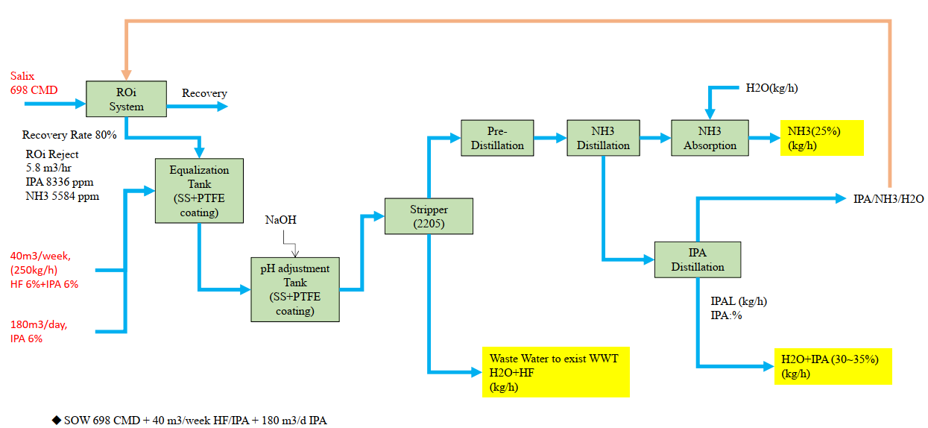
BLOCK FLOW DIAGRAM
Feed:
1000m3/day
(41.7 m3/h)
ROi Permeate
Flow: 31.7 m3/h
COD: <400 ppm
NH3-N: <5 ppm
Flow: 7.9 m3/h
IPA: 8200 ppm
NH4: 7400 ppm
20m3/day,
IPA 3.05% and
HF 1.54%
- pH , COD analyzer, H2O2 analyzer, Turbidity
- Conductivity, Ammonia analyzer
- pH
- Density for NH3
- IPA
Design Feed Capacity: 1000m3/day of Salix + 20m3/day IPA 3.05% and HF 1.54% + 180 m3/day of IPA 6%

Slide 9
PROJECT TIMELINE
Months | 1 | 2 | 3 | 4 | 5 | 6 | 7 | 8 | 9 | 10 | 11 | 12 | 13
Order
Detail Design and Submission / HAZOP
Equipment Purchase and deliver
Civil and Construction
Installation
Piping
Electrical MCC and Power Cabling Works
PLC and SCADA
Inspection / Testing and Star-up Commissioning & performance Test
Certification and Acceptance
Training

